Slide 1



iMAP
towards low-dose iL2 Market APproval
for autoimmune diseases
ANR- 16-RHUS-0001
21/04/2020
Notes:
1

Slide 2

iMAP data integration
Bosco Taddei, Caroline Peltier,
François-Xavier Lejeune, Arthur Tenenhaus,
Ivan Moszer

Slide 3
Outline
1- iMAP integrative analysis presentation
2- Preliminary results
A. Data presentation
B. Cytokines
C. Cytometry

Slide 4
1. iMAP integrative analysis presentation

Slide 5
17/01/2020
Biological questions
Biological questions
Explain variability in the data
IL2 impact?
Heterogeneity of reaction to IL2?
Responder or not?
Links with clinical variables?
By variable
By block
Multi-block
By timepoint
By timepoint
Difference to V01
Kinetics

Slide 6
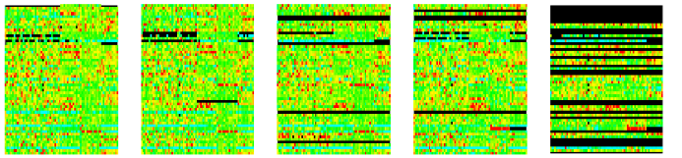
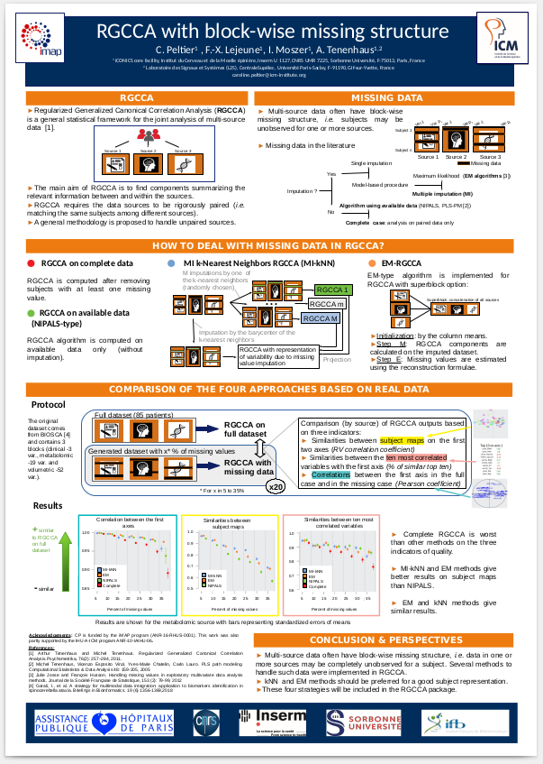
Methodology
25/03/2020
A. By timepoint approach
I- Univariate approach
II- Multivariate approach by block
III- Multiblock approach
B. T5 – baseline (same approaches)
C. Kinetics approach
Bosco’s internship for cytokine and cytometry
Caroline, Arthur, Federica: missing data, temporality & RGCCA + Recruiting a post-doc → meeting to organize?
Variable selection ?
→ Knowledge-based
→ method-based

Slide 7
Methods used
By timepoint
Compared to baseline
Kinetics
 | Univariate | Multivariate | Multiblock
Descriptive | Histogram | PCA | Unsupervised RGCCA
Discriminant (IL2 vs Placebo Resp/Non resp) | Wilcoxon-test with Bonferroni correction Boxplots | (s)PLS-DA | Supervised RGCCA
PCA: finds the axes maximizing the variability of the samples
(s)PLS-DA: finds the axes maximizing the differences between two given groups

Slide 8
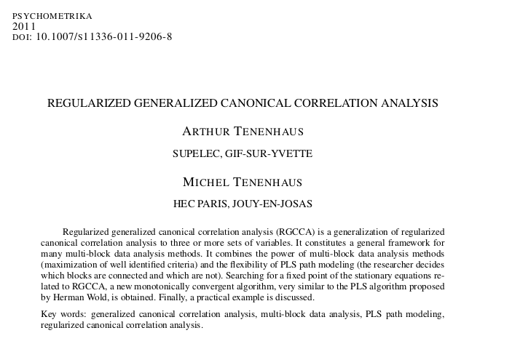

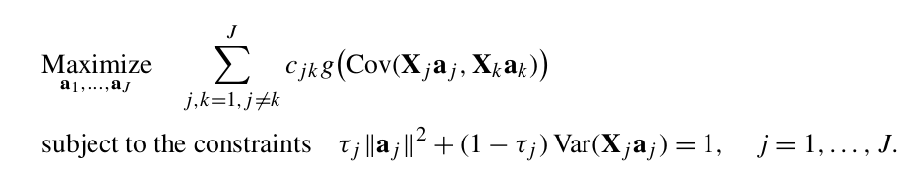
RGCCA: a multiblock method
Regularized Generalized Canonical Correlation Analysis
Idea: Reduction of the dimensionality of each block by one linear combination of variables (weight, a_{j}) maximizing a criteria linking the blocks all together
X_{j}: the centered blocks
Note :
If τ_{j} =1, the constraint is
||a_{j}||²=1
If τ_{j} = τ_{k}=0, Var( X_{j}a_{j} )=1 and
Cov( X_{j}a_{j} , X_{k}a_{k} )=Cor( X_{j}a_{j} , X_{k}a_{k} )
Ind. 1
X₁
X₂
X₃
Ind. n
Var. 1
Var. p
RGCCA
Y₁= X₁ a₁
Y₂
Y₃
c_{jk}: 1 if block j and k are related, 0 ifelse
g: a convex function (x, |x| or x²)
RGCCA results:
a_{j}: weights (vector of length p_{j})
Y_{j}: block components = X_{j} a_{j}
(vector of length n)
τ_{j}: a regularization constant between 0 or 1

Slide 9
Recovering other methods
With one block
τ_{j}=1 one block related to itself
g(x)=x
PCA
With two blocks
τ_{j}=0
(mode B) ; g(x)=x
Canonical Correlation Analysis (CCA)
τ_{j}=1
(mode A) ; g(x)=x
Partial Least Square Regression (PLS-R),
PLS-DA
With more blocks
τ_{j}=0
τ_{j}=0
g(x)= x
GCCA
τ_{j}=1
g(x)= x
Multiple PLS
Note: Deflation steps can be included in RGCCA, allowing to have more than 1 dimension per block

Slide 10

Other questions for multiblock approaches
Finding similarities between blocks
Similarities between blocks (2 by 2)
Variable selection and finding signature
method based (sparse option, by crossvalidation)
knowledge-based
Validation of signature
bootstrap
Preprocessing of the blocks is one of the most important step of multiblock analysis
→ Importance of the exploratory analysis

Slide 11
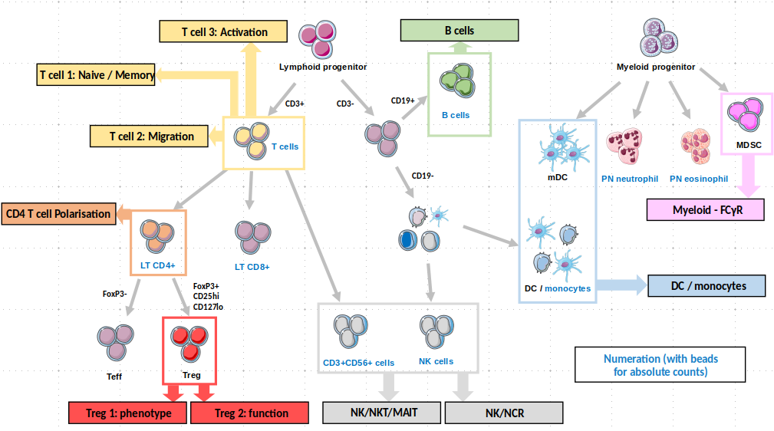
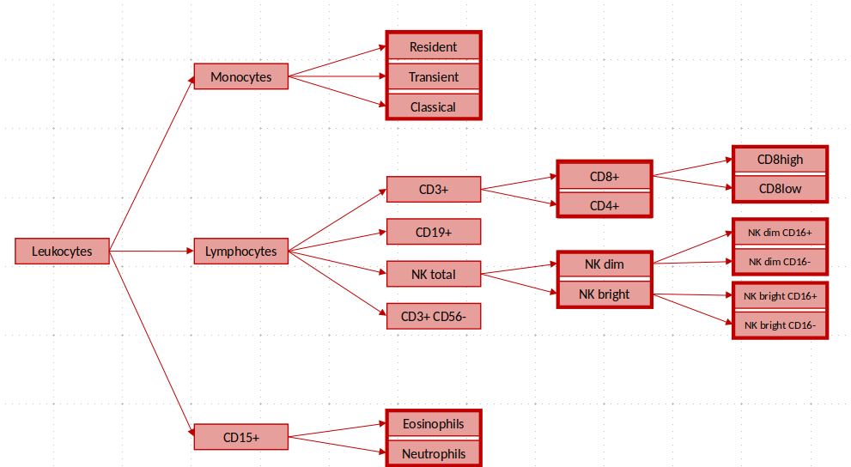
How to pretreat/analyze cytometry data properly ?
Very rich data structure
Several technical issues:
Some compositional data
Counts and percentages
Redundant information → variable selection?
An idea :
Use this structure in a multiblock framework

Slide 12
2. Preliminary results

Slide 13
2.A. Data presentation

Slide 14
Available data
Cytokine:
75 -> 63 variables
Cytometry:
492 variables
Contingency Table
Not normalized
 | Responder | Not Responder | Total
IL - 101 | 22 | 10 | 32
Placebo | 9 | 18 | 27
Total | 31 | 28 | 59

Slide 15
2.B. Cytokine data analysis

Slide 16
Results:
Univariate analysis (cytokine)
Variables with significant Wilcoxon test p-value
 | V01 | V05 | V09 | V17 | V29
IL2 vs Placebo (pval.max = 0,05/63) | N/a | sIL2Ra HSIL2 STNFRI STNFRII IP10 | sIL2Ra | N/a | N/a
Resp vs Non Resp in IL2 (pval.max = 0,05) | "IL.22" "IL.21" "IL.23" | "sCD30" "MIP3a" "IL.21" | "TGFb1" "TNFb" "MIP3a" "IL.17A" "IL.21" "IL.23" | "MIP3a" "IL.21" "IL.23" | N/a
Resp vs Non Resp in Placebo (pval.max = 0,05) | N/a | N/a | N/a | "GRO" | "sIL.4R"

Slide 17
Results:
Univariate analysis (cytokine)
Variables with significant Wilcoxon test p-value
 | V01 | V05 | V09 | V17 | V29
IL2 vs Placebo (pval.max = 0,05/63) | N/a | sIL2Ra HSIL2 STNFRI STNFRII IP10 | sIL2Ra | N/a | N/a
Resp vs Non Resp in IL2 (pval.max = 0,05) | "EGF" "MCP.1" "IL.22" "IL.21" "IL.23" | "TGFb1" "EGF" "MIP.1a" "IL.21" | "sCD40L" "IL.1RA" "MCP.1" "MIP.1b" "TNFb" "HSIL.1b" "MIP3a" "IL.21" | "MIP.1a" "MIP.1b" "MIP3a" "IL.21" | "MIP.1b" "IL.21"
Resp vs Non Resp in Placebo (pval.max = 0,05) | "IL.12p40" "MIP.1a" "IL.31" | "GRO" "HSIL.7" "IL.31" | "GRO" "sCD40L" "MIP.1a" "HSTNFa" | "HSTNFa" | "HSIL.7" "HSTNFa" "sIL.1RI"

Slide 18
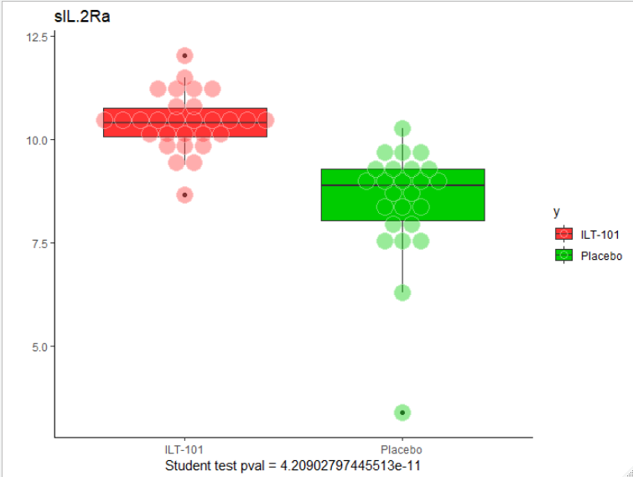
Results:
Univariate analysis (cytokine)
 | V01 | V05 | V09 | V17 | V29
IL2 vs Placebo Sig. variables | N/a | sIL2Ra HSIL2 STNFR I-II IP10 | sIL2Ra | N/a | N/a
Rep vs Non Rep Sig. variables | N/a | N/a | N/a | N/a | N/a
V05

Slide 19
Results cytokines:
Univariate analysis
(V05-V01)
Variables with significant Wilcoxon test p-value
 | V5-V1 | V09 -V01 | V17-V01 | V29-V01
IL2 vs Placebo | 9 variables | sIL2Ra | N/a | N/a
Resp vs Non Resp in IL2 (pval.max = 0,05) | "sCD40L" "HSIL.12p70" "sCD30" "IL.17E" | N/a | "IL.12p40" | "sIL.2Ra"
Resp vs Non Resp in Placebo (pval.max = 0,05) | "FGF.2" "IL.12p40" "HSIL.10" "HSIL.7" | "HSIL.6" | "HSIL.2" "HSTNFa" "sVEGFR1" | "IL.12p40" "HSGM.CSF" "HSIL.5"

Slide 20
Results cytokines:
Univariate analysis
(V05-V01)
Variables with significant Wilcoxon test p-value
 | V5-V1 | V09 -V01 | V17-V01 | V29-V01
IL2 vs Placebo | 9 variables | sIL2Ra | N/a | N/a
Resp vs Non Resp in IL2 (pval.max = 0,05) | "Eotaxin" "MCP.3" "HSIL.12p70" | "Fractalkine" "IL.17A" | "IL.12p40" | "EGF" "IP.10" "HSIL.5" "sVEGFR2"
Resp vs Non Resp in Placebo (pval.max = 0,05) | "IL.12p40" "MDC" "HSIL.10" "HSIL.2" | "IL.15" "HSIL.6" "MIP3a" | N/a | "MCP.3" "IL.12p40" "IL.15" "HSGM.CSF" "HSIL.5"

Slide 21
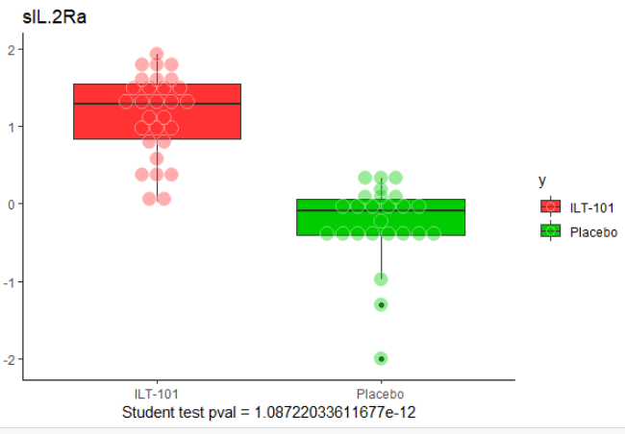
Results cytokines:
Univariate analysis
(Baseline to visit evolution)
 | V5-V1 | V09 -V01 | V17-V01 | V29-V01
IL2 vs Placebo | 9 | sIL2Ra | N/a | N/a
Rep vs Non Rep | N/a | N/a | N/a | N/a
V05 – V01

Slide 22
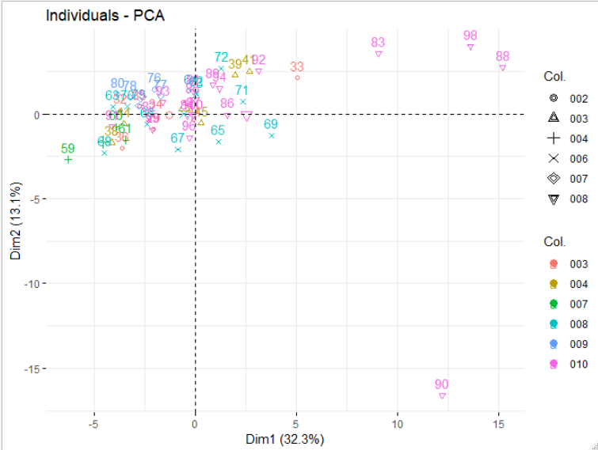
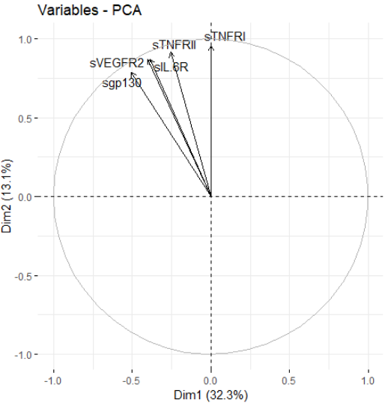
Multivariate Analysis : PCA V01
90 : 010-001-033
Minimal et outlier (-3sd) on 5 variables
5 most correlated variables
Need to correct for country ?

Slide 23
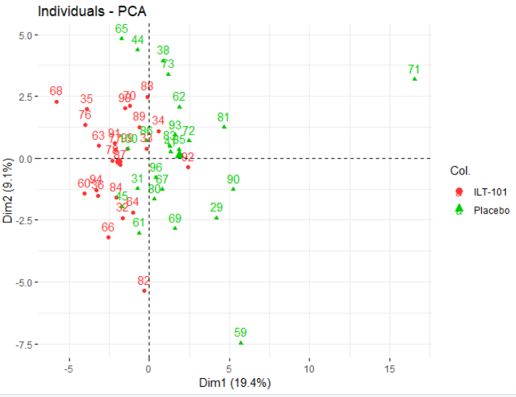
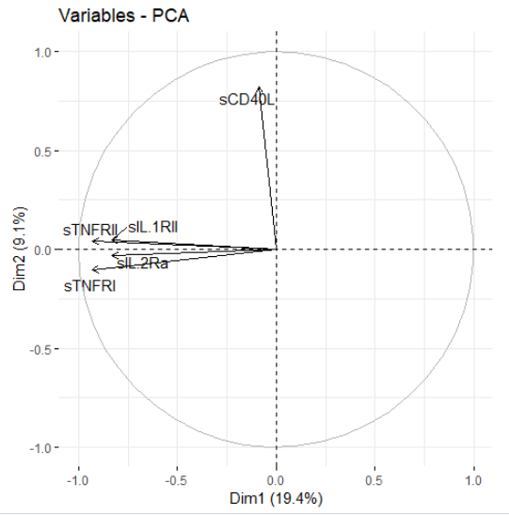
Multivariate Analysis : PCA V05- V01
5 most correlated variables

Slide 24
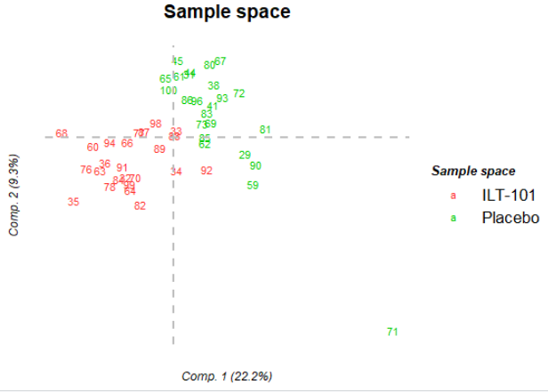
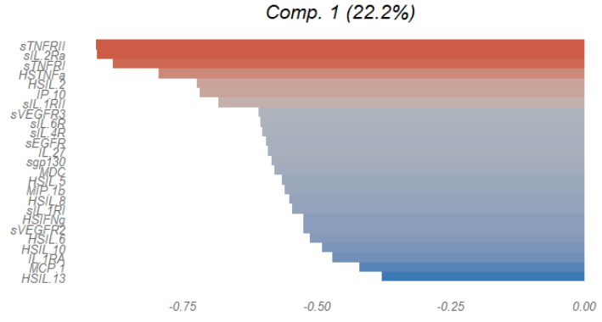
Multivariate Analysis:
PLS-DA V05 - V01

Slide 25
Cytokine Synthesis
 | Expected | Observed
IL2 action | ↑ IL2RA+ | Most significant effect at V05-V01 and V05 Effect seems fading over time Noticeable effect : ↑ IL2RA+, HSIL2, STNFRI, STNFRII, IP10 To be confirmed (Cross validation, bootstrap)

Slide 26
2.C. Cytometry data analysis

Slide 27
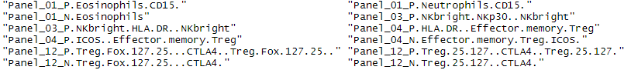
Results cytometry:
Univariate analysis
Number of variables with significant Wilcoxon test p-value
 | V01 | V05 | V09 | V17 | V29 | V30
IL2 vs Placebo | N/a | 12 | 8 | 3 | 3 | N/a
V05
V09
V17
V29

Slide 28
Results cytometry:
Univariate analysis
Number of variables with significant Wilcoxon test p-value
 | V5-V1 | V09 -V01 | V17-V01 | V29-V01
IL2 vs Placebo | 53 | 12 | 7 | N/a
3 common significant variables V5 – V1 -> V9 – V1
4 common significant variables V9 – V1 -> V17 – V1
1 common significant variables V5 – V1 -> V17 – V1

Slide 29
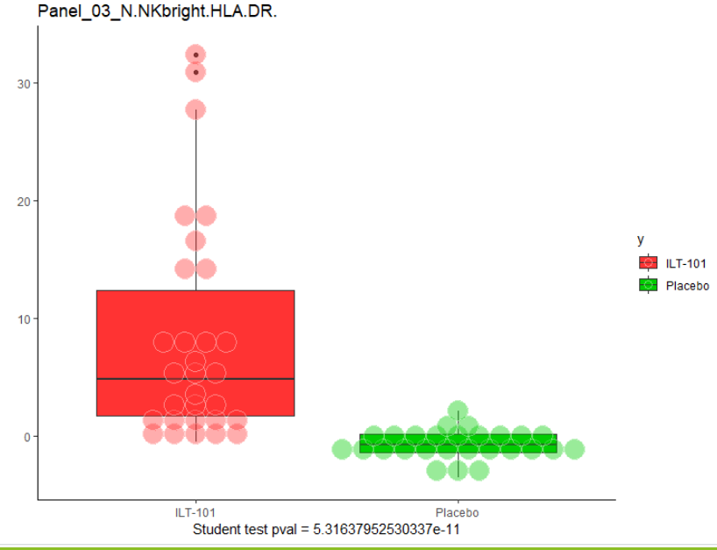
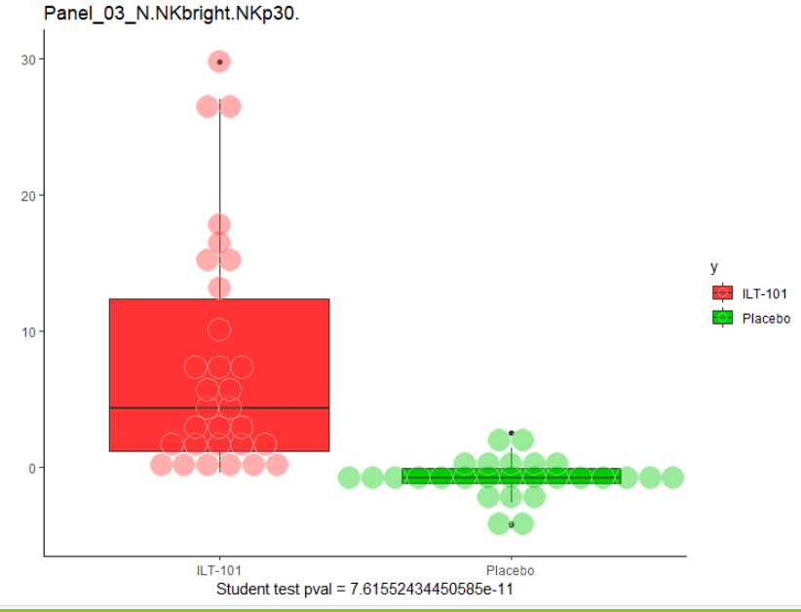
Results cytometry:
Univariate analysis
Number of variables with significant Wilcoxon test p-value
 | V5-V1 | V09 -V01 | V17-V01 | V29-V01
IL2 vs Placebo | 53 | 12 | 7 | N/a
Rep vs Non Rep | N/a | N/a | N/a | N/a
V05 – V01
V05 – V01

Slide 30
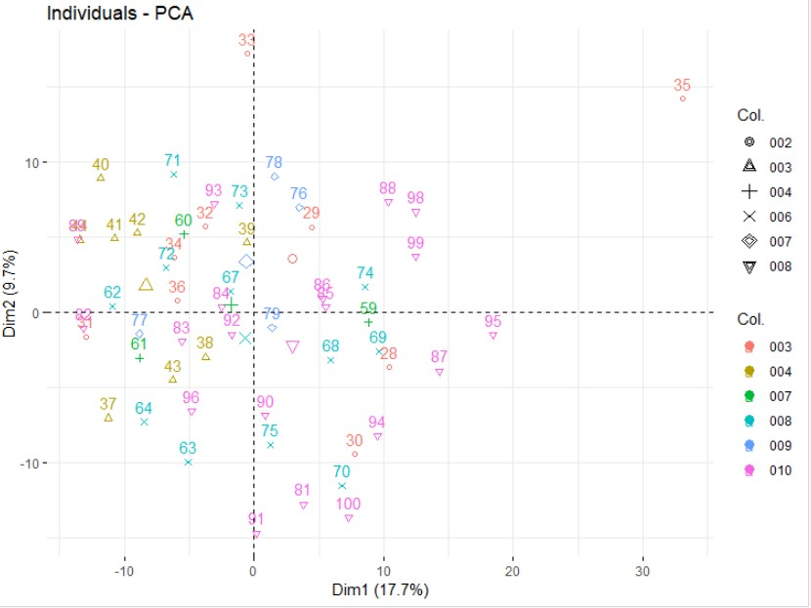
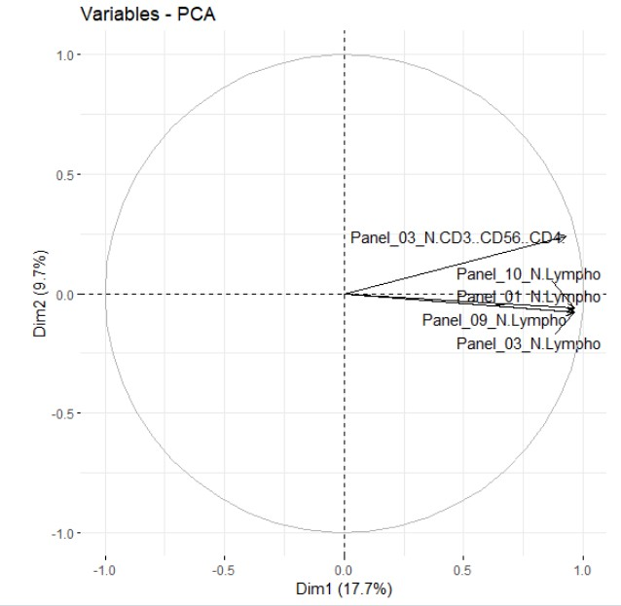
Multivariate Analysis : PCA V01
5 most correlated variables
Need to correct for country ?

Slide 31
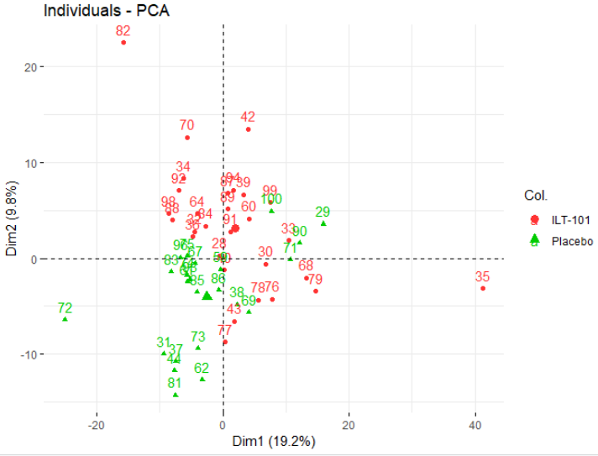
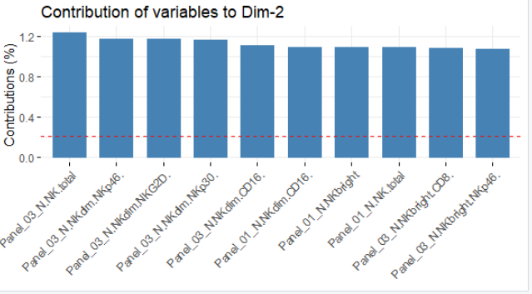
PCA IL2 vs. Placebo
(V05 – V01, cytometrie)

Slide 32
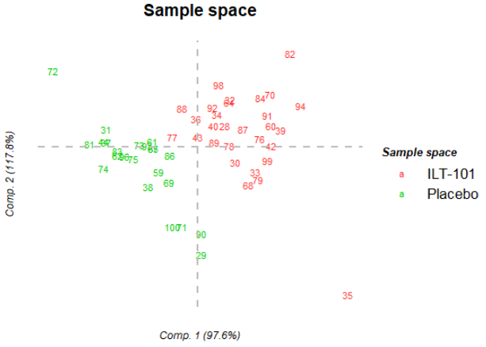
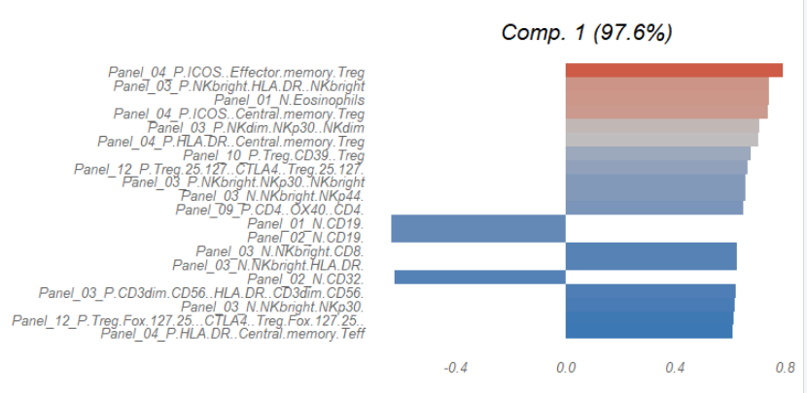
PLS-DA IL2 vs. Placebo (V05 – V01, cytometry)

Slide 33
Cytometry Synthesis
 | Expected | Observed
IL2 action | ↑ Treg (Foxp3+ cells); ↑ NK CD56bright | Most significant effect at V05-V01 and V05 Effect seems to be fading over time Many significant variables, evolving across time To be confirmed (Cross validation, bootstrap)

Slide 34
Next steps
Responder vs. Non responder in IL2 group ?
Signature and validity ?
Links with clinical variables ?
Multiblock approaches (RGCCA) ?
What about non-linear methods ?

Slide 35
Thanks for your attention

Slide 36
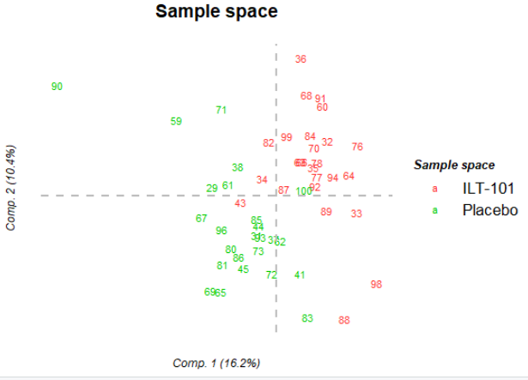
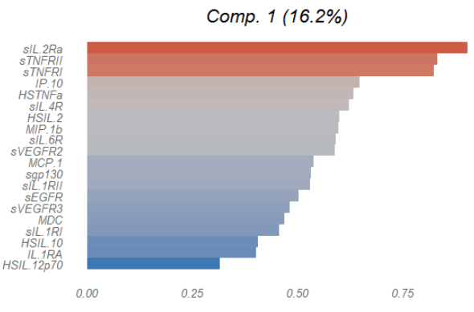
Multivariate Analysis:
PLS-DA V05

Slide 37
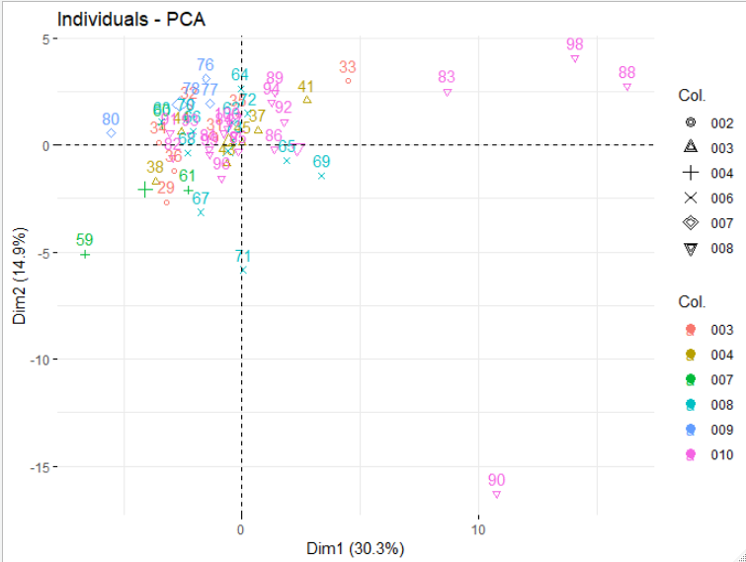
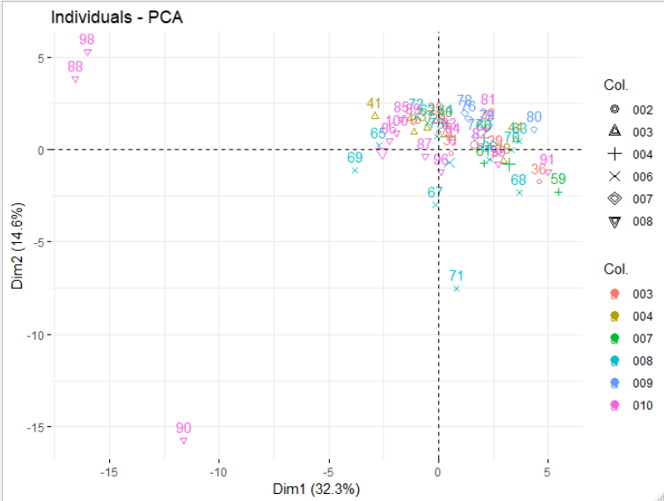
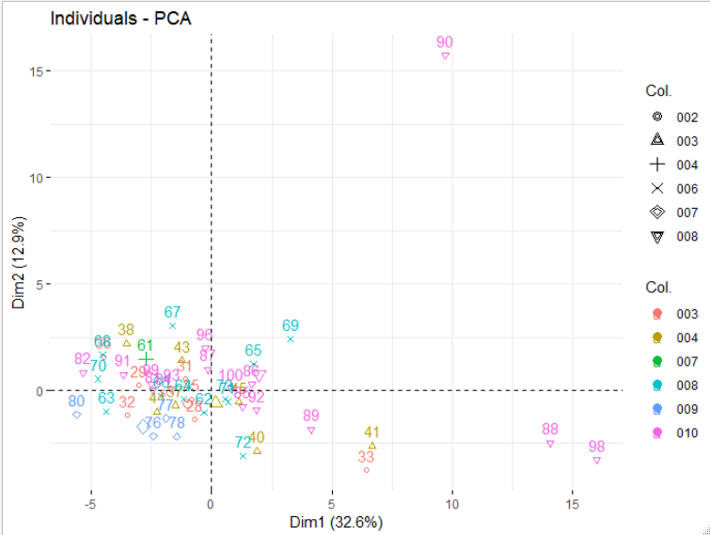
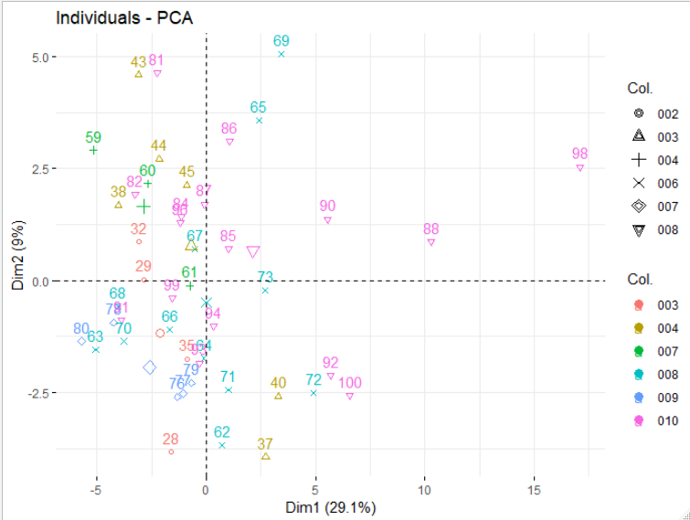
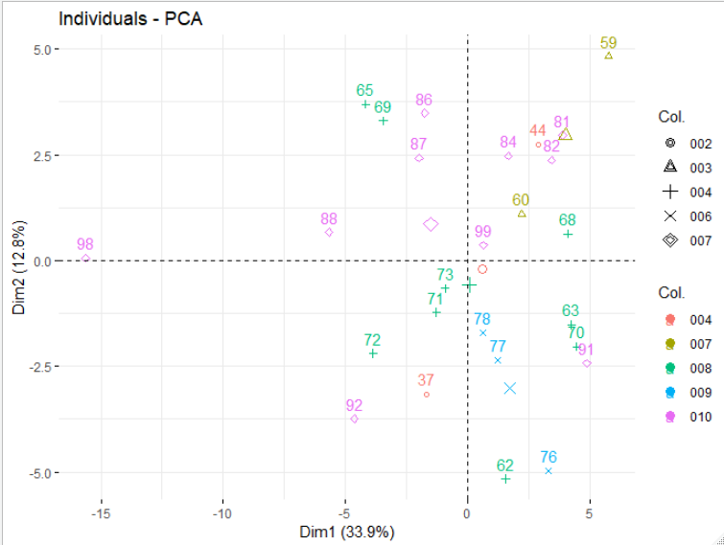
PCA Cytokine
V01
V05
V09
V17
V17
V29
V30

Slide 38
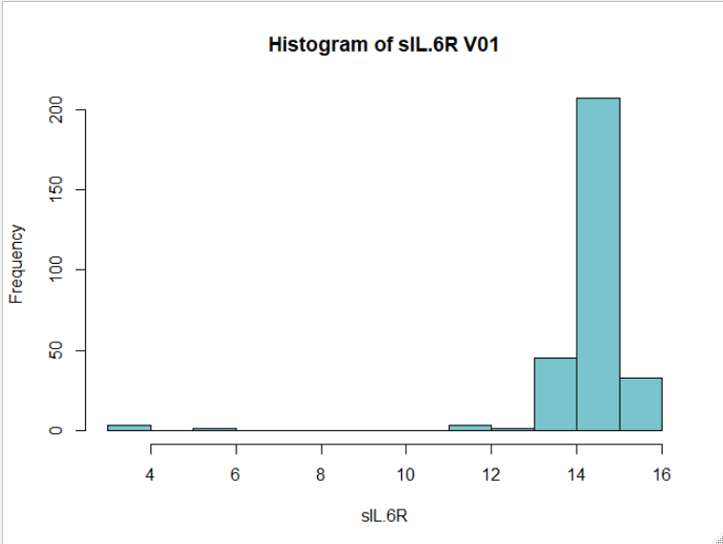
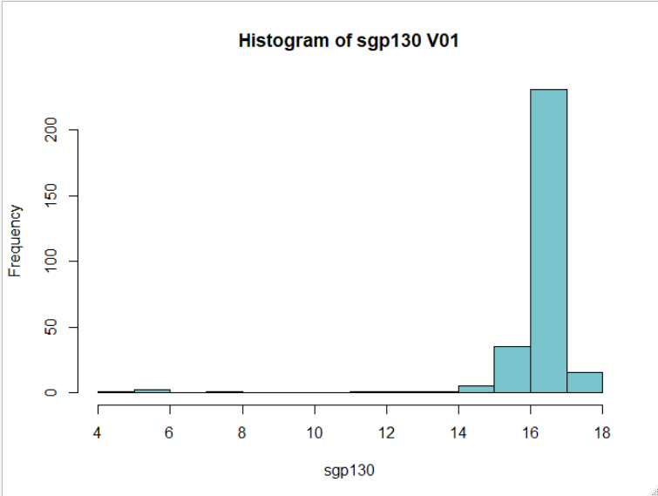
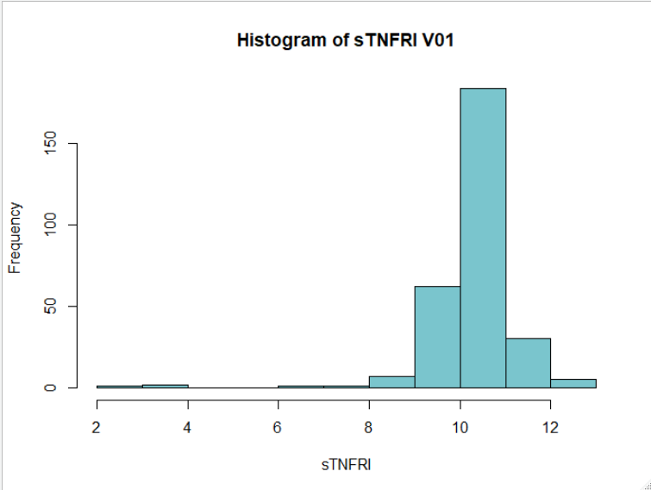
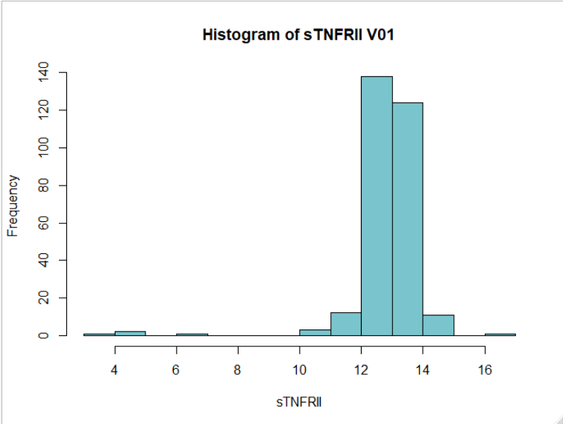
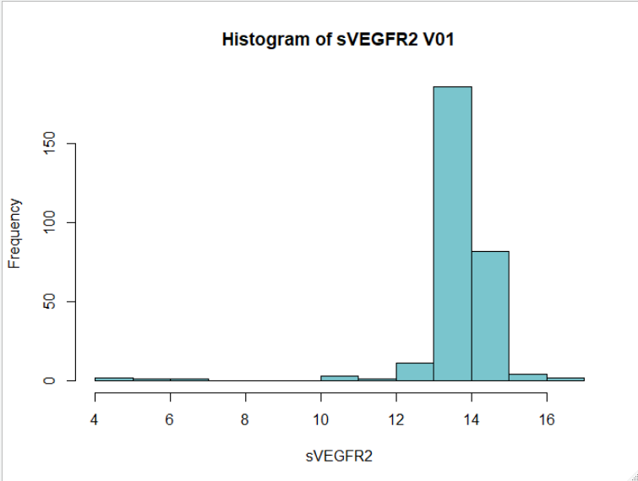
010-001-032 is min

Slide 39
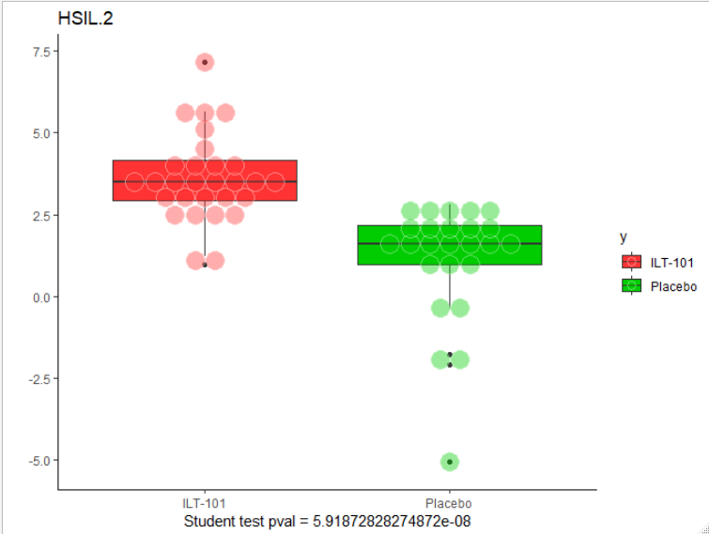
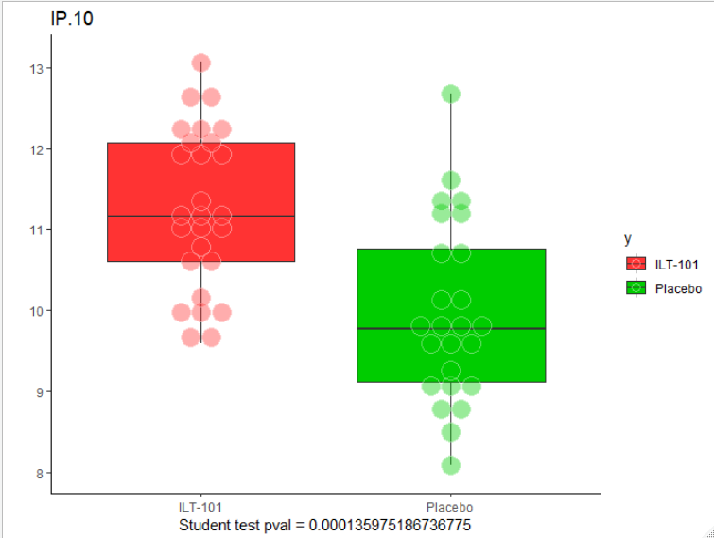
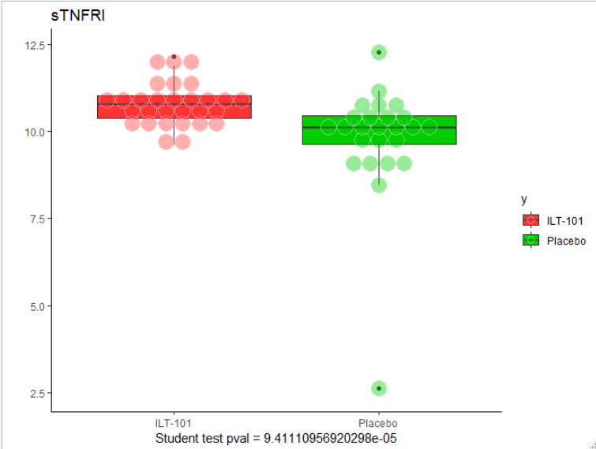
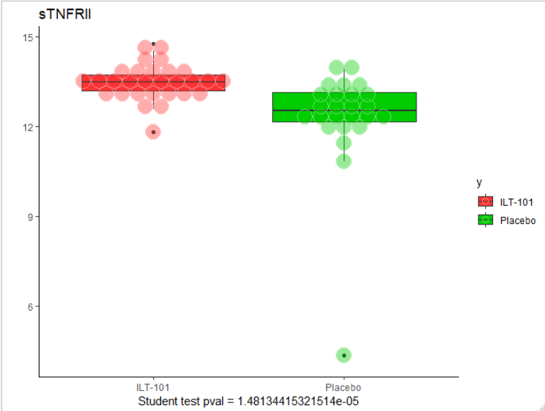
IL 2 response V05

Slide 40
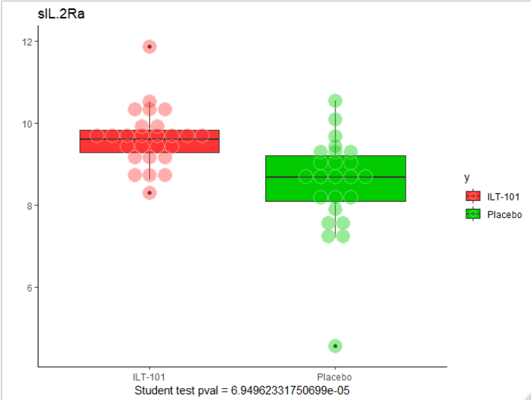
IL 2 Response V09

Slide 41
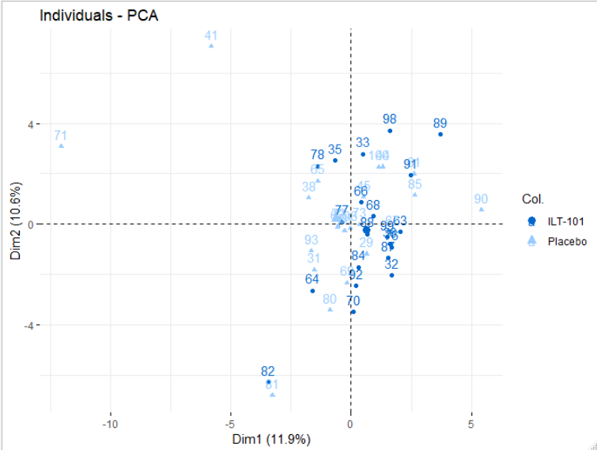
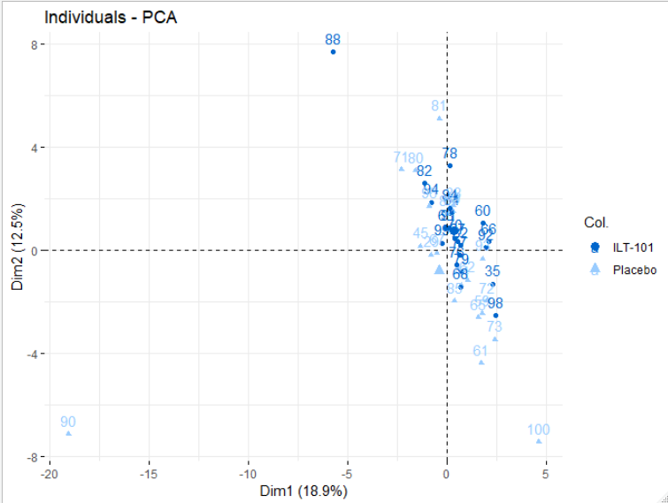
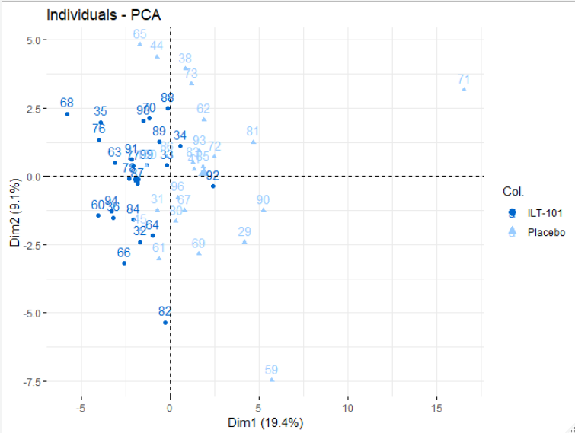
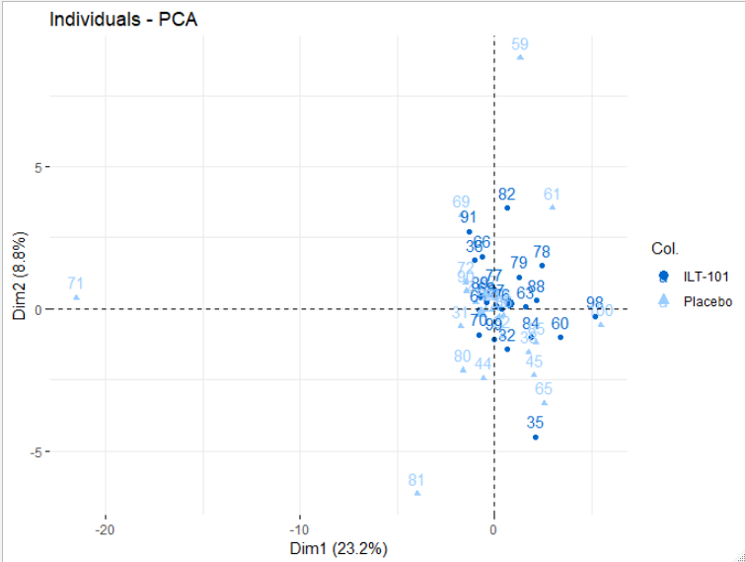
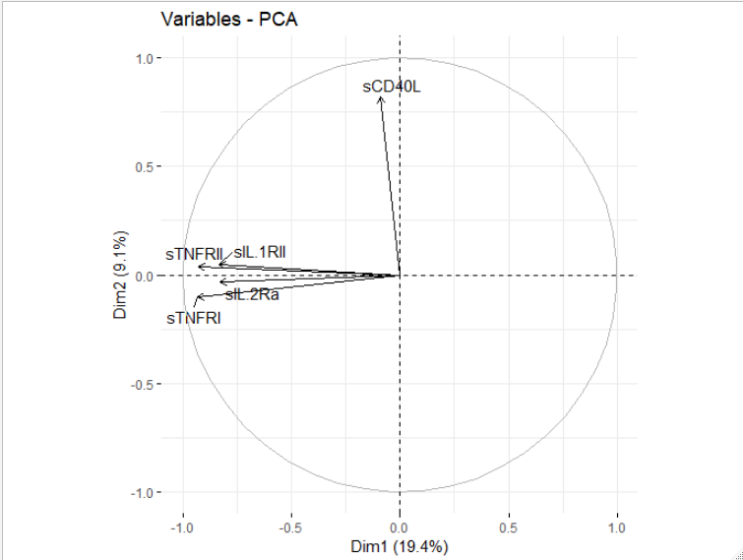
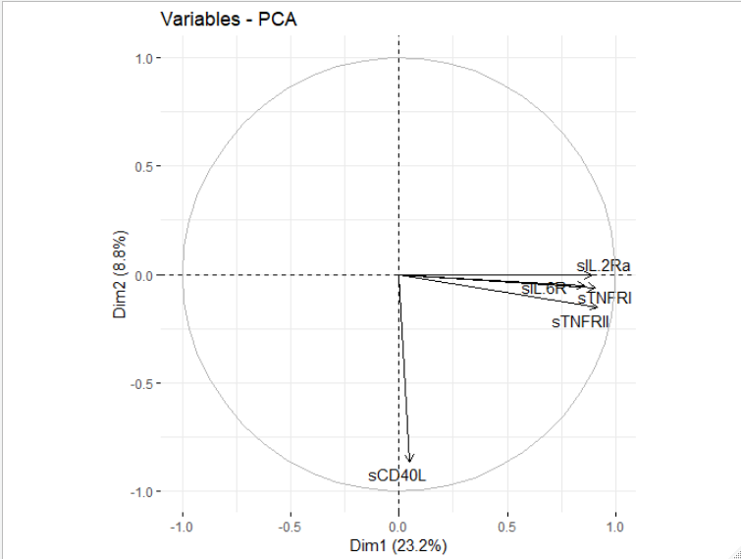
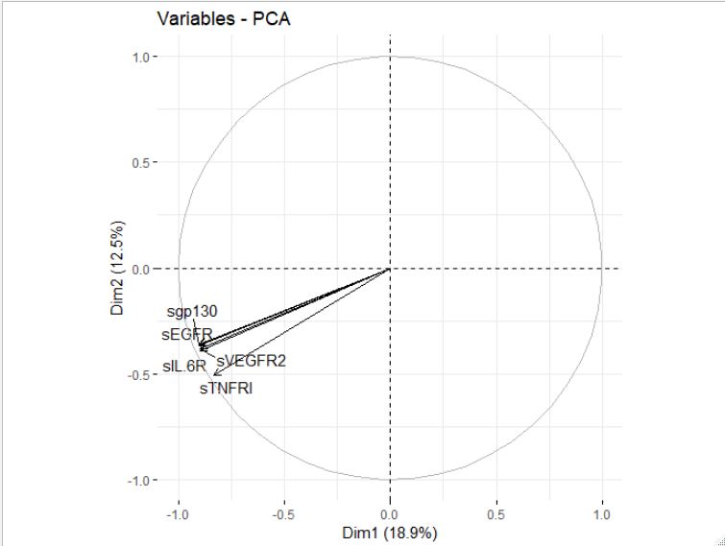
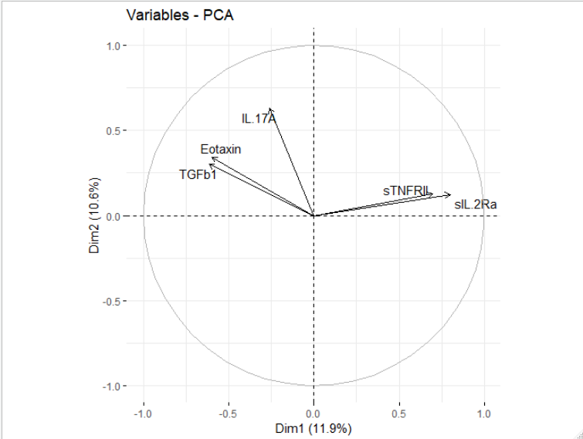
IL 2 Response PCA V05 – V01

Slide 42
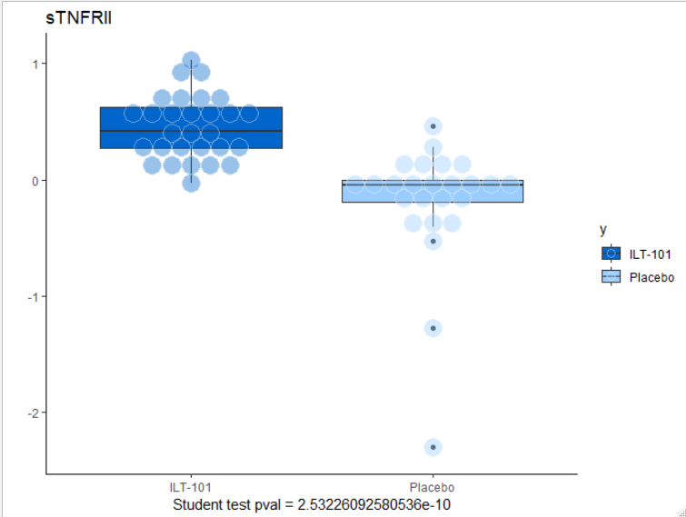
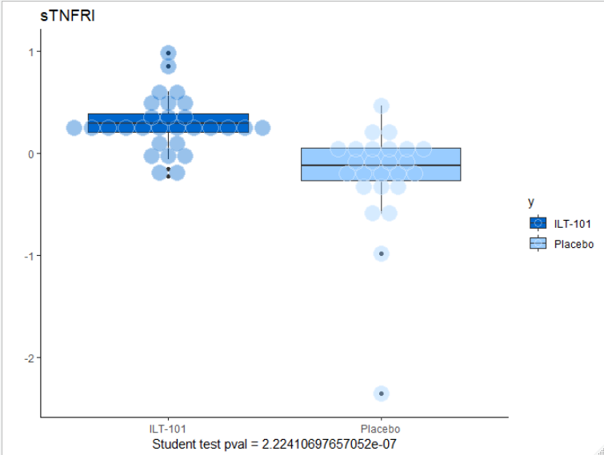







IL 2 Response V5- V1

Slide 43

IL 2 Response V9- V1

Slide 44






Slide 45




IL 2 Response Cytometry per visit

Slide 46







Visit - Baseline

Slide 47
Suite (V17)

